Slide 1




Kendo UI ASP.NET MVC Wrappers
ASP.NET MVC
Telerik School Academy
http://academy.telerik.com

Slide 2

Table of Contents
Kendo UI Summary and Installation
Kendo HTML Helpers
Kendo Widgets
Kendo Grid
Kendo DataViz
Live Application Build

Slide 3
Kendo UI
http://www.kendoui.com/

Slide 4
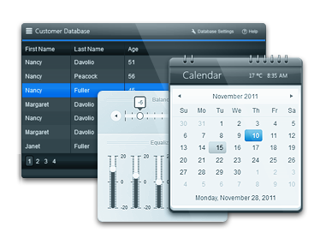
What is Kendo UI?
Framework for building modern interactive web applications
Collection of script files and resources (styles, images, etc.)
Leverages
JavaScript
HTML5
CSS3
jQuery

Slide 5

What Does Kendo UI Provide?
Rich UI Widgets
HTML5 controls based on jQuery Core
3 categories of UI Widgets
Web
DataViz
Mobile
Client-side DataSource
Abstraction for working with all types of data on the client side

Slide 6
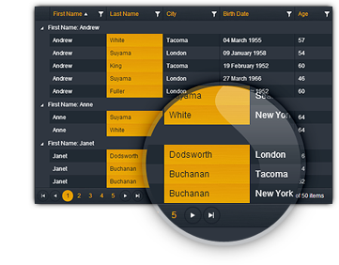
What Does Kendo UI Provide?
MVVM Framework
Provides declarative binding and two-way data synchronization in your web application
Animation and Drag & Drop
Templating
Validation Framework
Server wrappers
ASP.NET MVC
Java and PHP

Slide 7
Include Kendo UI in Project
Download Kendo UI Complete for MVC
Copy and reference Kendo.Mvc.dll
Located in: ...\wrappers\aspnetmvc\Binaries\Mvc5
Copy the provided version of jQuery
Copy JavaScript files into ~\Scripts\Kendo
js\kendo.all.min.js and js\kendo.aspnetmvc.min.js
Copy CSS files and images into ~\Content
All from …\styles to ~Content\Kendo

Slide 8
Include Kendo UI in Project
Create bundles for jQuery and Kendo
Create bundles for CSS
Clear the ignore list for the bundles
bundles.Add(new
ScriptBundle("~/bundles/jquery").Include(
"~/Scripts/Kendo/jquery.min.js"));
bundles.Add(new
ScriptBundle("~/bundles/kendo").Include(
"~/Scripts/Kendo/kendo.web.min.js“,
"~/Scripts/Kendo/kendo.aspnetmvc.min.js"));
bundles.Add(new
StyleBundle("~/Content/kendo").Include(
"~/Content/kendo.common.*",
"~/Content/kendo.default.*"));

Slide 9
Include Kendo UI in Project
Register bundles (if not already)
Render the bundles in your Layout page
protected void Application_Start()
{
…
BundleConfig.RegisterBundles(BundleTable.Bundles);
…
}
<head>
<!-- other content -->
@Styles.Render("~/Content/kendo")
@Scripts.Render("~/bundles/kendo") // after jQuery
</head>

Slide 10
Include Kendo UI in Project
Add Kendo namespace in web.config for the Views folder
<system.web.webPages.razor>
<pages pageBaseType="System.Web.Mvc.WebViewPage">
<namespaces>
<add namespace="System.Web.Mvc" />
<add namespace="System.Web.Mvc.Ajax" />
<add namespace="System.Web.Mvc.Html" />
<add namespace="System.Web.Optimization"/>
<add namespace="System.Web.Routing" />
<add namespace="Kendo.Mvc.UI" />
</namespaces>
</pages>
</system.web.webPages.razor>

Slide 11
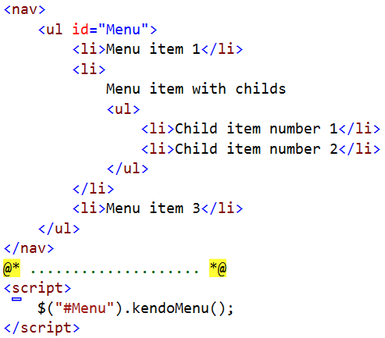

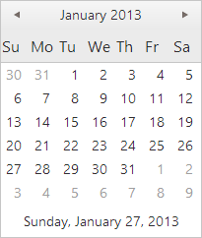
Using Kendo UI
Pure HTML and JavaScript
ASP.NET MVC wrappers
Kendo code MUST be after jQuery reference!

Slide 12
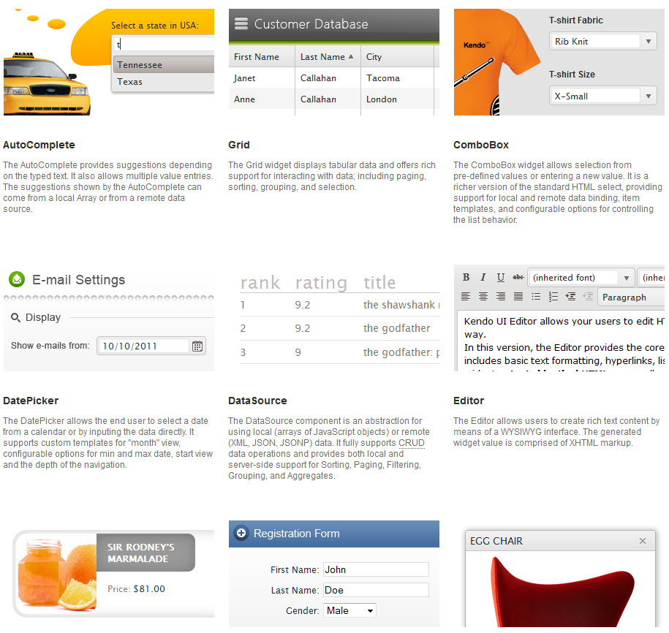
Installing Kendo UI for MVC
Documentation here!

Slide 13
Kendo UI HTML Helpers
http://www.kendoui.com/

Slide 14
Kendo UI HTML Helpers
HTML Helpers
Lightweight C# objects
Auto-generate markup within a View
Return HTML and JavaScript to the browser
Provide Fluent API
Can be used in both Web Forms and Razor
Easily customized through JavaScript and jQuery

Slide 15
Kendo UI HTML Helpers
Some Web Widgets
AutoComplete
Calendar
DropDownList
Upload
TreeView
Grid
Some DataViz Widgets
Chart
LinearGauge
RadialGauge

Slide 16
Kendo UI HTML Helpers
Usage of helpers
@(Html.Kendo().Grid((IEnumerable<Models.Product>)
ViewBag.Products)
.Name("grid")
.Columns(columns =>
{
columns.Bound(pr => pr.ProductID);
columns.Bound(pr => pr.ProductName);
columns.Bound(pr => pr.UnitsInStock);
})
.Pageable()
.Sortable()
)

Slide 17
Kendo UI MVC Helpers
Live Demo

Slide 18
Kendo UI ASP.NET MVC Wrappers
http://academy.telerik.com

Slide 19
Homework
Create the WebForms “Library System” exam with ASP.NET MVC and Kendo UI Server Side Wrappers using as much widgets as you can:
TreeView for the Home page
Grid for the Administration
AutoComplete for the Search input
DropDownList for category selection
Others

Slide 20



Free Trainings @ Telerik Academy
“C# Programming @ Telerik Academy
csharpfundamentals.telerik.com
Telerik Software Academy
academy.telerik.com
Telerik Academy @ Facebook
facebook.com/TelerikAcademy
Telerik Software Academy Forums
forums.academy.telerik.com

